Slide 1
Outline
Looping
Find relationships between variables
Loop for counts (count array)
Flag
Nested Loops – A loop inside another loop
Today
A Challenging Example (Selection Sort)
Break and continue
Notes:
Reading List

Slide 2
Looping IV
Selection Sort
break
continue

Slide 3
1. Challenging Example (Selection Sort)
Selection Sort is a sorting method that involves a simple 2-layer nested loop
Selection Sort is among the first algorithm you learn in this course
An algorithm is a set of instructions that one can follow to solve a general set of problems

Slide 4
1. Challenging Example (Selection Sort)
int A[6] = { 4, 5, 7, 2, 9, 1 };
How do we sort it? Step by step
A[6] = {1, 2, 4, 5, 7, 9}
Translate into programming

Slide 5
1. Challenging Example (Selection Sort)
int A[6] = { 4, 5, 7, 2, 9, 1 };
How do we sort it? Step by step
Find the smallest one, put it in the first place
Find the smallest in the rest numbers, put it in the second place
… …
Repeat for all numbers
A[6] = {1, 2, 4, 5, 7, 9}
Translate into programming

Slide 6
1. Challenging Example (Selection Sort)
int A[6] = { 4, 5, 7, 2, 9, 1 };
Swap:
Temp=x;
x=y;
y=temp;
X is A[index]
Y is A[index]
Iteration # | Step 1: Subarray to be processed: A[i] … A[N-1] | Step 2: Locate the smallest # in the sub-array | Step 3: Swap the smallest # with A[i]
i = 0 | 4 5 7 2 9 1 | 4 5 7 2 9 1 | 1 5 7 2 9 4
i = 1 | 1 5 7 2 9 4 | 1 5 7 2 9 4 | 1 2 7 5 9 4
i = 2 | 1 2 7 5 9 4 | 1 2 7 5 9 4 | 1 2 4 5 9 7
i = 3 | 1 2 4 5 9 7 | 1 2 4 5 9 7 | 1 2 4 5 9 7
i = 4 | 1 2 4 5 9 7 | 1 2 4 5 9 7 | 1 2 4 5 7 9
N=6
i
i
This part is sorted!
i
i
(N-2)
i

Slide 7
1. Challenging Example (Selection Sort)
// Pseudocode:
// Given an array A[] of size N
for i = 0 to N-2 { //step 1, do N-1 times
minPos = position of the smallest element
among A[i] … A[N-1]; //step 2
Swap A[i] with A[minPos]; //step3
}
// Note: When there is only one element left, we do not
// need to perform the steps in the loop.
// Therefore, the loop only needs to iterate
// N-1 times (i.e., from 0 to N-2).
Find the smallest value, location
remember the location(index), not the value
According to index, easily get the value A[index]

Slide 8
1
2
3
4
5
6
7
8
9
10
11
12
13
14
15
16
17
18
19
20
21
22
// Suppose A[] contains N numbers. The following segment of
// code sorts the data in the array so that
// A[0] <= A[1] <= ... <= A[N-2] <= A[N-1]
int i, j, minPos, tmp;
for ( i = 0; i < N-1; i++ ) { //step1, do N-1 times
// Locate the smallest element among A[i] … A[N-1],
// and store the location of it in minPos. //step2
minPos = i;
for ( j = i+1; j < N; j++ )
if ( A[ j ] < A[ minPos ] )
minPos = j;
// Swap A[i] with A[minPos] only if necessary //step3
if (minPos != i) {
tmp = A[ i ];
A[ i ] = A[ minPos ];
A[ minPos ] = tmp;
}
}
Find the smallest for N-1 times
Find the min in the rest numbers, record the index
Swap the value, if needed
Challenging Example (Selection Sort)

Slide 9
Outline
A Challenging Example (Selection Sort)
Break and continue

Slide 10
2. Break and continue
break statement
Exit the current loop
Same in for and while
continue statement
Exit the current iteration and continue the next time
Different in for and while

Slide 11
2.1. What is break?
End this Loop
while (LoopCondition) {
statement1;
if (BreakCondition)
break;
statement2; update;
}
statement3;
for (init; LoopCondition; update) {
statement1;
if (BreakCondition)
break;
statement2;
}
statement3;
init
statement2 &
update
Early Exit in a Loop
The break statement, when executed, causes the program to leave the closest enclosing loop immediately.
false
Loop
Condition
Break
Condition
true
true
false
statement1
statement3

Slide 12
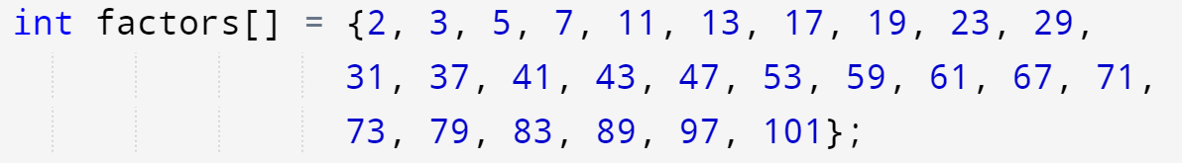
Lab 6 Ex4, Prime or composite?
Before the Loop
int flag=0; // Prime(Default)
Inside the Loop
if find any factors, flag=1 //mark as composite
After the loop, output
if flag is 1 -> Composite
if flag is 0 -> Prime
Flag
and
Break

Slide 13
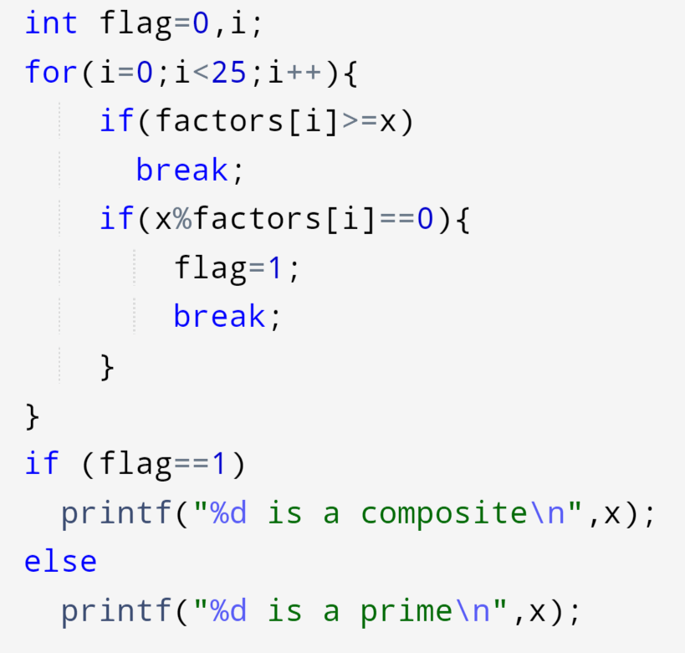
Flag: Lab 6 Ex4, Prime or composite?
If the factor is greater
End the loop
If find any factor
mark as composite
End the loop

Slide 14
2.2. Examples of break statement
1
2
3
4
5
6
7
8
9
10
11
12
13
14
15
int input, sum = 0; // To store input value and their sum
while (1) { // Use "break" to stop the loop instead
printf("Input: ");
scanf("%d", &input);
if (input == 0)
break; // Loop will stop when input value is 0
sum = sum + input;
}
printf("Sum = %d\n", sum);
Rewriting the example from Looping (I).
Input: 1
Input: 3
Input: 5
Input: 7
Input: 0
Sum = 16

Slide 15
2.2. Examples of break statement
Using break to stop a for loop
1
2
3
4
5
6
7
8
9
10
11
int i;
for (i = 0; i < 10; i++) {
if (i == 3)
break; // break the loop if i is 3
printf("%d\n", i);
}
printf("Bye!\n");
0
1
2
Bye!

Slide 16
2.2. Another Example
To compare if two arrays have the same content, we need to compare their elements one by one. As soon as we encounter the first difference between the two arrays, we can stop early using break!
1
2
3
4
5
6
7
8
9
10
11
12
13
int A[5], B[5], i;
int hasSameContent;
… // Suppose A and B are assigned some values here
hasSameContent = 1; // Assume they have the same content
for (i = 0; i < 5; i++) {
if (A[i] != B[i]) {
hasSameContent = 0; // different content is found!
break;
}
}
// After the loop, if hasSameContent remains to be 1,
// then the arrays have the same content
E.g.
hasSameContent turns 0 when i equals 3 here
A | 5 | 4 | 3 | 2 | 1
B | 5 | 4 | 3 | 3 | 1

Slide 17
2. Break and continue
break statement
Exit the current loop
Same in for and while
continue statement
Exit the current iteration and continue the next time
Different in for and while

Slide 18
2.3. What is continue?
Skip this iteration
Continue next iteration
for (init; LoopCondition; update) {
statement1;
if (continueCondition)
continue;
statement2;
}
statement3;
init
update
statement2
false
true
Continuation in a Loop
The continue statement, when executed, causes the program to skip the remaining statements in the closest enclosing loop for the current iteration.
Loop
Condition
Continue
Condition
true
false
statement1
statement3

Slide 19
2.4. Examples of continue statement
for-loop version
1
2
3
4
5
6
7
8
9
10
11
int i;
for (i = 0; i < 10; i++) {
if (i == 3)
continue;
printf("%d\n", i); // skipped if i is 3
}
printf("Bye!\n");
0
1
2
4
5
6
7
8
9
Bye!

Slide 20
2.3. What is continue?
Skip this iteration
Continue next iteration
init
while ( LoopCondition ) {
statement1;
if (continueCondition)
continue;
statement2;
}
statement3;
statement2
false
true
Loop
Condition
Continue
Condition
true
false
statement1
statement3
The while-loop version

Slide 21
2.4. Examples of continue statement
while-loop version
1
2
3
4
5
6
7
8
9
10
11
12
int i;
i = 0;
while (i < 10) {
if (i == 3)
continue;
printf("%d\n", i); // skipped if i is 3
i++; // skipped too if i is 3
}
printf("Bye!\n");
i=3, no update
the loop will iterate forever.

Slide 22
2.4. Examples of continue statement
while-loop version
1
2
3
4
5
6
7
8
9
10
11
12
int i;
i = 0;
while (i < 10) {
if (i == 3) {
i++;
continue;
}
printf("%d\n", i); // skipped if i is 3
i++; // skipped too if i is 3
}
printf("Bye!\n");
0
1
2
4
5
6
7
8
9
Bye!
The i++ at line 10 will be skipped when continue is executed. Without the i++ at line 6, the loop will iterate forever.

Slide 23
2. Break and continue
break statement
Exit the current loop
continue statement
Exit the current iteration and continue the next time
In for loop, jump to update(i++) and the next iteration
In while loop, remember to update(i++) before continue

Slide 24
Loop Summary
Looping
while, for
Flag
Loop for counts (count array)
Find relationships between variables
Nested Loops – A loop inside another loop
A Challenging Example (Selection Sort)
Break and continue
Break: Exit the current loop
Continue: Exit the current iteration and continue the next iteration

Slide 25
Reading Assignment
C: How to Program, 8th ed, Deitel and Deitel
Chapter 3 Structured Program Development in C
Sections 3.7 – 3.10
Chapter 4 C Program Control
Sections 4.1 – 4.6, 4.9

